Slide 1
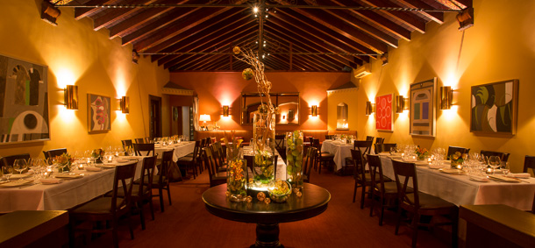
Cmpe 226 Database Design Fall 2015
Data Analysis of SF Restaurant Health Inspection
Guided by: Prof. Ronald Mak
Team Name: Snowlions
Submitted By:
Romin Oushana
Deepthi Toopran
Akanksha Jain
Mounica Nekkalapudi

Slide 2
Introduction
Purpose
Investigating the relationship between San Francisco restaurant health inspection scores and violations (provided by the Department of Health and Hygiene) and various restaurant characteristics.
Every restaurant in San Francisco City must have yearly, surprise inspections in order to remain in operation. At inspection, points are assigned for every violation, dependent on violation type and category. The number of points are summed to the restaurant’s score.
We analyzed Violation , Inspection and Score information in relation to Business over different parameters with details obtained from the health inspection data set.
Target Audience
Restaurant owners and consumers

Slide 3
Funtionality
Web Application
User invokes data operation through http request
Web Server- Apache + PHP
Serves the Web browser with dynamic and static requests through PHP code running on server
Database – MySQL
Data id fetched by Web server

Slide 4
Technologies Used
CIS
RDBMS
Data Warehouse.
Web development: PHP, Javascript, Json, Google Charts API
Prepared Statements

Slide 5
Sources of data
Selection of Data because:
It is well-maintained, comprehensive, and current.
Sounds interesting and practical for users to obtain data about the restaurants to visit.
Inform about health parameters maintained by city’s Health inspection department.

Slide 6
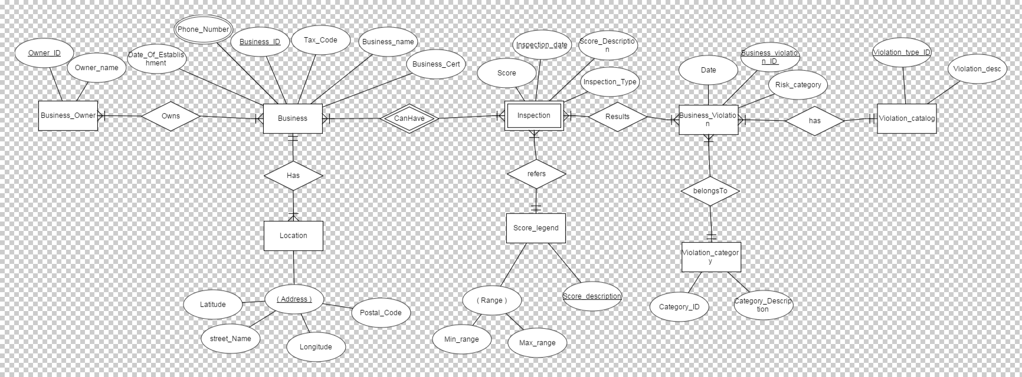
ER Diagram

Slide 7
Data models
Operational Model:
Includes operational data for businesses such as business owner details, location details, score details, inspection details , violation category details.
Includes Basic Operations for getting information for business location details , owner details , violation data and inspection data.

Slide 8
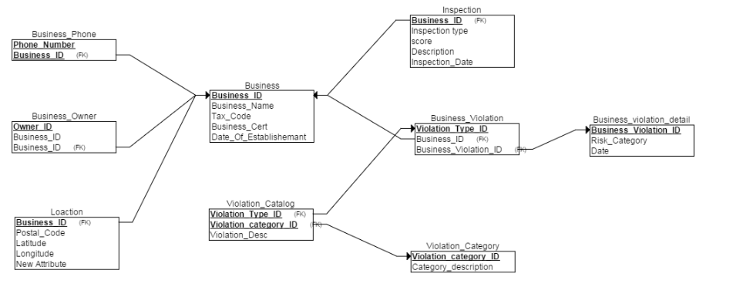
Relational Schema

Slide 9
Dimensional Model
Contains subject oriented analytical database
Dimension Tables and fact tables
Dimension tables: 5 tables
Description of business, location, violation, score, calendar tables for subject oriented analysis.
Fact Tables: 2 tables
Contains foreign keys from dimension table and measures related to subject of analysis – Violation and Inspection

Slide 10
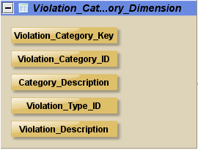
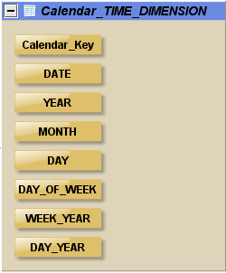
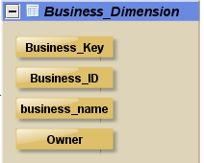
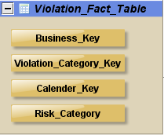
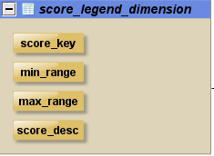
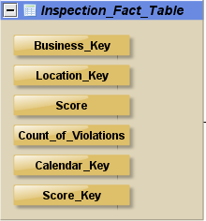
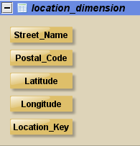
Data models
Dimension and Fact Tables

Slide 11
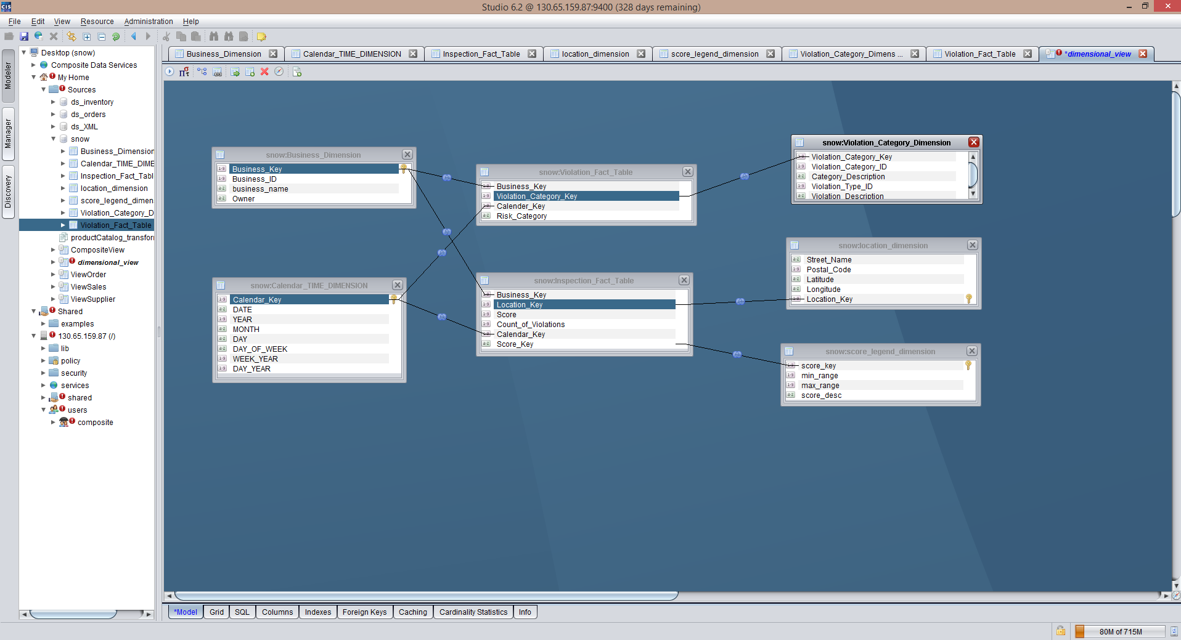
Dimensional Model

Slide 12
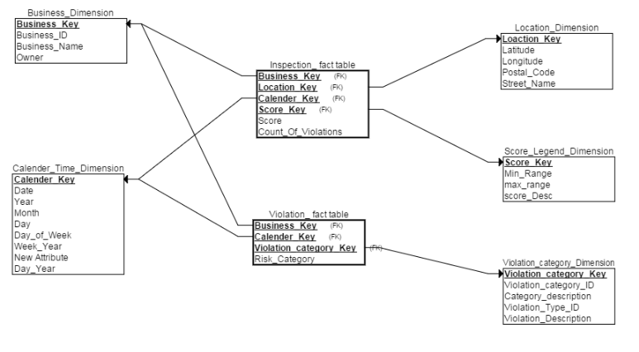
Dimensional(star) schema

Slide 13
Operational vs Dimensional
Operational data operation includes basic querying operations such as
Location details
Owner Details
Violations for business
Inspection for business
Analytical data Operation
Includes complex Queries for analysis of data in Dimensional table.
Patterns of violations and the types of violations during years for a particular business.
Number of Inspections for businesses during a month/year

Slide 14
Data operations
Slice and Dice
Pivot
Drill down Operation
SELECT Business_Dimension.business_name,Calendar_TIME_DIMENSION.MONTH,Inspection_Fact_Table.Score FROM`Inspection_Fact_Table`,Calendar_TIME_DIMENSION,Business_Dimension WHERE Inspection_Fact_Table.Calendar_Key=Calendar_TIME_DIMENSION.Calendar_Key AND Business_Dimension.Business_Key=Inspection_Fact_Table.Business_Key AND Calendar_TIME_DIMENSION.YEAR ="2014" AND Business_Dimension.Business_ID = 10

Slide 15
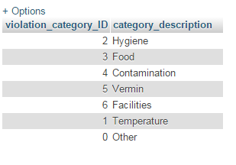
Analysis and visualisation
Types Of Violations

Slide 16
Analysis and visualisation
Analysis based on a particular restaurant business based on average score per year/month.
Analysis based on number of times a particular restaurant is inspected in an year/month.
Analysis based on a particular restaurant under which category the restaurant business is violated.

Slide 17
Analysis and visualisation
Analyze number of violations in each category for all the businesses
Analyze the average score ranges of all businesses
Analyze range of violations for all businesses.

Slide 18
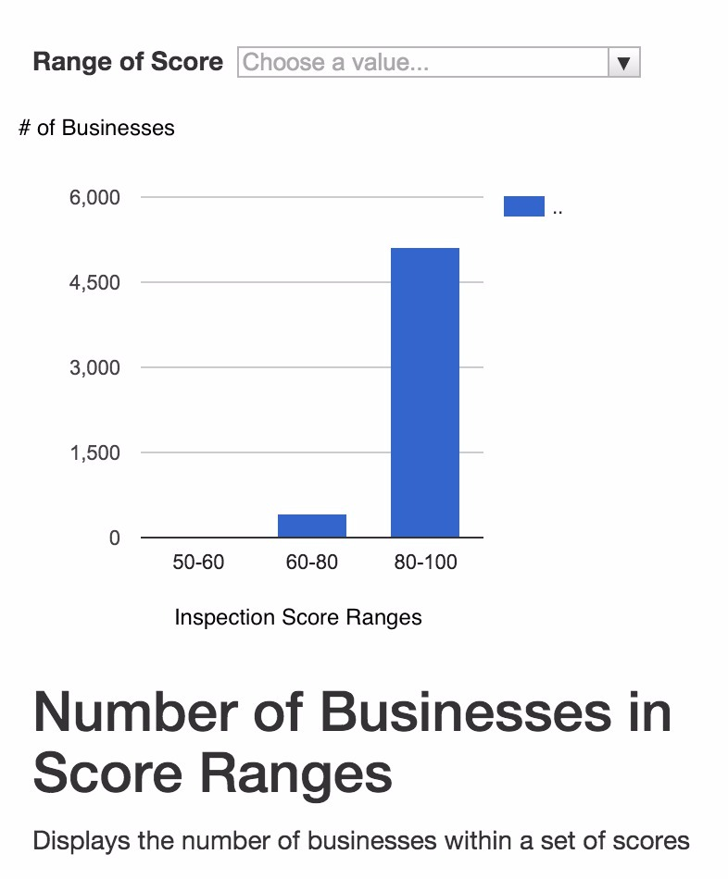
Analytical Results

Slide 19
Results
Restaurant owners could use the analytical results to optimize the expected inspection grade based on their evaluation of the likely violations.
Owners of the Restaurants can focus on improvements in this area in particular.
Customers can refer to the analytical results which will help them to choose a better restaurant based on location and scores.

Slide 20
DEMO

